Slide 1
SQL Project Evaluation

Slide 2
What is data about to ?
We have date set of music industry in this data set we have we have 11 tables and each table define one specific thing about music data

Slide 3
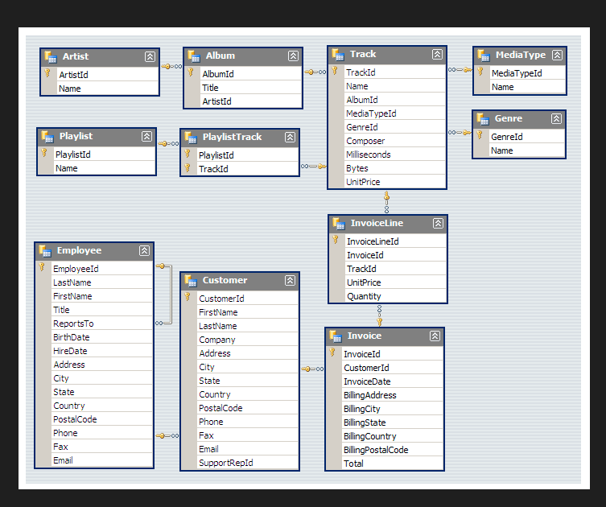
This is schema of whole table in music data

Slide 4
#1. Who is the senior most employee based on job title?
The most senior employee based on job title is Andrew because Andrew is General Manager of company and most of employee report to Andrew
Name Title max(report)
Andrew | General Manager | 9

Slide 5
# Which countries have the most Invoices?
France has most invoices of all.
country invoices
France | 23.76

Slide 6
#What are top 3 values of total invoice?
The top three values of total invoices are-
Country Invoices
France | 23.76
Canada | 19.8
Czech Republic | 19.8

Slide 7
4. Which city has the best customers? We would like to throw a promotional Music Festival in the city we made the most money. Write a query that returns one city that has the highest sum of invoice totals. Return both the city name & sum of all invoice totals ?
Edmonton city has best customers if we compare other cities because Edmonton city has highest invoices of all city.
City sum(total invoices)
Edmonton | 29.699999999999996

Slide 8
5. Who is the best customer? The customer who has spent the most money will be declared the best customer. Write a query that returns the person who has spent the most money ?
Wyatt Girard is best customer among of all customers because he is spending the height money
First Name Last Name total money
Wyatt | Girard | 23.76

Slide 9
1. Write query to return the email, first name, last name, & Genre of all Rock Music listeners. Return your list ordered alphabetically by email starting with A ?
Aaron | Mitchell | aaronmitchell@yahoo.ca | Rock
Aaron | Mitchell | aaronmitchell@yahoo.ca | Rock
Aaron | Mitchell | aaronmitchell@yahoo.ca | Rock
Alexandre | Rocha | alero@uol.com.br | Latin
Alexandre | Rocha | alero@uol.com.br | Rock
Astrid | Gruber | astrid.gruber@apple.at | Rock
Astrid | Gruber | astrid.gruber@apple.at | Rock
Astrid | Gruber | astrid.gruber@apple.at | Metal
Astrid | Gruber | astrid.gruber@apple.at | Rock
Astrid | Gruber | astrid.gruber@apple.at | Metal
Alexandre | Rocha | alero@uol.com.br | Latin
Aaron | Mitchell | aaronmitchell@yahoo.ca | Rock
Aaron | Mitchell | aaronmitchell@yahoo.ca | Metal
Alexandre | Rocha | alero@uol.com.br | Metal
Astrid | Gruber | astrid.gruber@apple.at | Rock
Astrid | Gruber | astrid.gruber@apple.at | Rock
Astrid | Gruber | astrid.gruber@apple.at | Metal
Astrid | Gruber | astrid.gruber@apple.at | Rock

Slide 10
2. Let's invite the artists who have written the most rock music in our dataset. Write a query that returns the Artist name and total track count of the top 10 rock bands ?
AC/DC | 18
Aerosmith | 15
Audioslave | 14
Led Zeppelin | 14
Alanis Morissette | 13
Alice In Chains | 12
Frank Zappa & Captain Beefheart | 9
Accept | 4

Slide 11
3. Return all the track names that have a song length longer than the average song length. Return the Name and Milliseconds for each track. Order by the song length with the longest songs listed first?
How Many More Times | 711836
Advance Romance | 677694
Sleeping Village | 644571
You Shook Me(2) | 619467
Talkin' 'Bout Women Obviously | 589531
Stratus | 582086
No More Tears | 555075
The Alchemist | 509413
Wheels Of Confusion / The Straightener | 494524
Book Of Thel | 494393

Slide 12
1. Find how much amount spent by each customer on artists? Write a query to return customer name, artist name and total spent ?
Aaron | Alanis Morissette | 167.31000000000003
John | AC/DC | 99.00000000000001
Jack | Alice In Chains | 21.78
Frank | AC/DC | 17.82
Astrid | Alanis Morissette | 10.89
Edward | Aerosmith | 10.89
Rishabh | Buddy Guy | 10.89
Leonie | Buddy Guy | 9.9
Daan | Apocalyptica | 9.9
Mark | Black Sabbath | 9.9

